Slide 1
जीवन संरक्षण समूह SAVE LIVES FOUNDATION Bafal, Kathmandu

Slide 2
Save Lives Foundation (SLF) is a non profitable, non-governmental, non-political affiliated and fully independent organization formed in February 2008A.D. The organization is registered with the chief district office in Kathmandu, Nepal.
The registration number is 1098. The foundation is also registered with the Nepal office of Child Welfare and Social Welfare. The organization has 8 board members:
Chairperson- Uma Mathema
Secretary- Ashmita Bayalkoti
Treasurer- Rasmila Tamang
Members- Om Narayan Shrestha
-Luni Chochoon
-Sabitri Manandhar
-Ambika Kafle
-Vijaya Shrestha
General member- Saraswoti Timilsina
The organization emphasizes on providing proper education( school fee, books, copies, etc) and better future for the children. We believe in raising the children in a manner that will create an admirable, well independent member of the society. The organization is committed for providing an atmosphere full of love, respect and kindness. The organization believes in Education for Development. It gives festival allowance once in a year.

Slide 3
When the organization was established in 2008 A.D. there were 8 board members. They are:
Om Narayan Shrestha
Uma Mathema
Abhishek Chhochoon
Rakesh Prajapati
Biju Sahukhala
Shubha Ram Bhakta Mathema
Nhuche Narayan Shrestha
Sushmita Sakya

Slide 4
Objectives of SLF
The organization will be a non-profit public welfare social organization.
Helping orphans and the poor for overall development by making them moral and competent.
Arranging the care and education of orphans and poor who are deprived of education due to poor economic conditions.
Providing care and food for the elderly who are abandoned by the society and family.
Creating an environment in which women are facing difficulties due to economic, social and other reasons can live in the society.

Slide 5
As we are connected with KIKN, London, we had agreement of amount Rs.87,99,519.
We received Rs.75,22,166.42 for 80/81 financial year’s projects and the remaining balance from 79/80 financial year was Rs.2,17,024.05 and the total available balance was Rs.77,39,190.47.
The expenses was Rs.73,47,269.15 which is divided into following:
Program Cost- Rs.48,74,992.50
Project Cost Breakdown
Breakfast- Rs.24,87,700
Other programs- Rs.14,67,804
School fee, student support- Rs.9,19,488.50
Salary- Rs.10,70,000
Administration- Rs.14,02,276.65
The remaining balance is Rs. 3,91,921.26

Slide 6
The organization was established in 2008 A.D. with 8 children which was dedicated to give proper education, nurtured the children staying at the orphanage. The orphanage was closed down on 2022. Between all these, organization started sponsoring students from different schools form 2009 A.D. providing them with stationary items, uniforms and their school fee. Also, we are providing them with day meal at school. We were working with 7 schools till last year and currently working with 8 schools:
Neel Barahi Sec School –Tankeshwor, Kathmandu
Lubhoo Sec School-Mahalaxminagarpalika, Lubhu
Ishwor Basic School- Bhagwanpau Swayambhu, Kathmandu
Buddha Madhyamik Vidyalaya- Godawari nagarpalika, Kathmandu
Nepal Adarsha Sec School-Ganabahal, Kathmandu
Guheshwori Sec School- Thapathali, Kathmandu
Janabikash Sec School- Kuleshwor, Kathmandu
Jagat Sundar Bwonekuthi -Lakhutirtha Chagal, Kathmandu

Slide 7
The schools are provided with following programs:
- Neel Barahi Secondary School
The school is provided with day tiffin for 150 students. This program allows the students along with their parents to sent their children to school with ease. There are 3 students with scholarship from our organization. We provide them with fee, stationary and uniform. It is also provided with 1 computer teacher and 1 karate teacher.
- Lubhoo Secondary School
The school is provided with day tiffin for 150 students. This program allows the students along with their parents to sent their children to school with ease. There are 6 students with scholarship from our organization. We provide them with fee, stationary and uniform for whole educational year.
- Shree Buddha Secondary School
The school is provided with day tiffin for 100 students. This program allows the students along with their parents to sent their children to school with ease. It is also provided with file cabinet along with files to keep the students profile which helps them to understand about each students. 1 helper is provide in the same school.

Slide 8
- Shree Ishwor Basic School
The school is provided with day tiffin for 85 students. This program allows the students along with their parents to sent their children to school with ease. The whole students are provided with uniform, winter jacket, stationary ( exercise books, pencils, books for 14 students for newly established KG class). Computer lab is also established with 14 computers. The school is also provided with electricity and water bills along with 1 helper.
- Nepal Adarsa Secondary School
The school is provided with Music lab and math lab.
- Guheshwori Secondary School
The school is provided with smart boards.
- Jana Bikash Secondary School
The school is provided with full ECD class setup which includes stationary ( books, pencils, exercise books, colors, coloring books), music system, furniture, toys.

Slide 9
The organization has been sponsoring 32 children. Among them 20 children are doing their schooling and rest 12
are studying in college.
S.N | Student Name | College and Schools Name | Subject
1 | Sujan Rana Praja | Cosmos College | BBA
2 | Furna Sangmu Tamang | Shepherd College | BMT
3 | Sarmila Mahat | Golden Gate College | Psychology
4 | Panjum Tamang | Tri Chandra college | BSC Math
5 | Urmila Ghale | Nepal Law College | B.A.L.L.B.
6 | Pramila Tamang | Siddhartha School | Class 12
7 | Anjana Gajmer | Janamaitri Multipel Campus | B.Ed
9 | Raj Kumar B.KA | Janamaitri Multipal campus | B.Ed.
10 | Sunita Shrestha | Janamaitri Multipal Campus | B.Ed
11 | Smriti Lama | College of Central State | BBS
12 | Deepak Negi | School of Environmental Science and Management | BBA

Slide 10
13 | Muna B.KA. | Janamaitri Multipal campus | B.A.
14 | Kamala Uparkoti | Nepal Law Campus | B.A.
15 | Binita Rai | Shree Lubhoo S. School | class 12
16 | Prajita Thapa | Neel Barahai S .School | Class 9
17 | Upashna maharjan | Shree lubhoo S. School | Class 11
18 | Manju Thing | Shree lubhoo S. School | Class 11
19 | Simran Rai | Shree lubhoo S. School | Class 10
20 | Sarika Thapa | Shree Lubhoo S. School | Class 9
21 | Radhika Thapa | Shree Lubhoo S. School | Class 10
22 | Sujan Gole | Vidya Mandir S.School | Class 8
23 | Sasikala Sitaula | Neel Barahi S .School | Class 6
24 | Radha Gupta | Neel Barahi S .School | Class 7
25 | Rebika shrestha | Neel Barahi S .School | class 6
26 | Rimisa Rana Magar | Shree Buddha S.School | Class 5
27 | Saloni Maharjan | Shree Buddha S.School | Class 4
28 | Astha Rumba | Shree Buddha S.School | class 3
29 | Astha Bisankhe | Shree Buddha S.School | Class 3
30 | Soni Pariyar | Shree Buddha S.School | Class 3
31 | Arati Budhathokhi | Shree Buddha S.School | Class 4
32 | Sajina Magarati | Neel Barahi S. school | Class 6

Slide 11
Assets of Save Lives Foundation
Computer -1
Computer table-1
Printer-1
File cabinet-1
Chair-1
Laptop-1
Sofa-3
Table-1
Flooring
Kitchen Equipment's
Mats

Slide 12
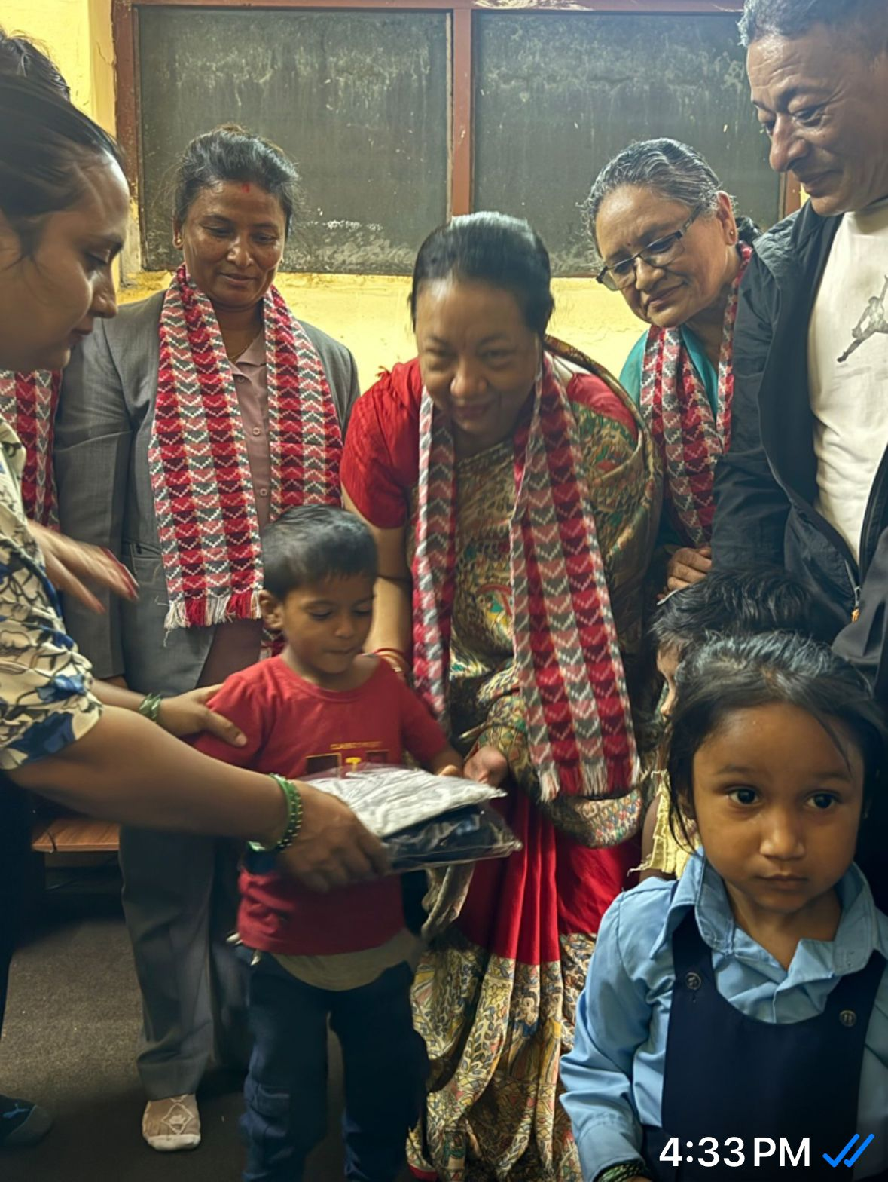
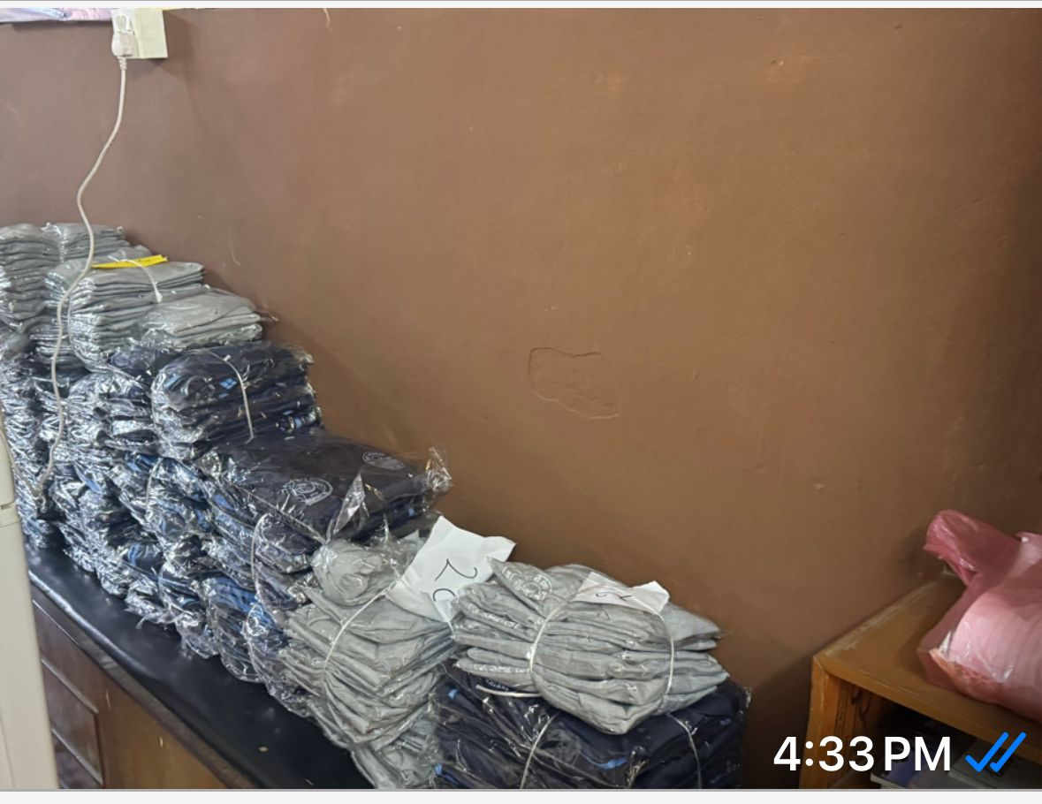
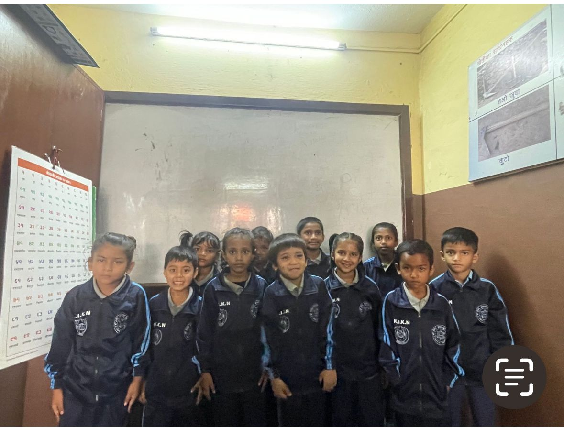
Uniform Distribution at Ishwor Basic School

Slide 13
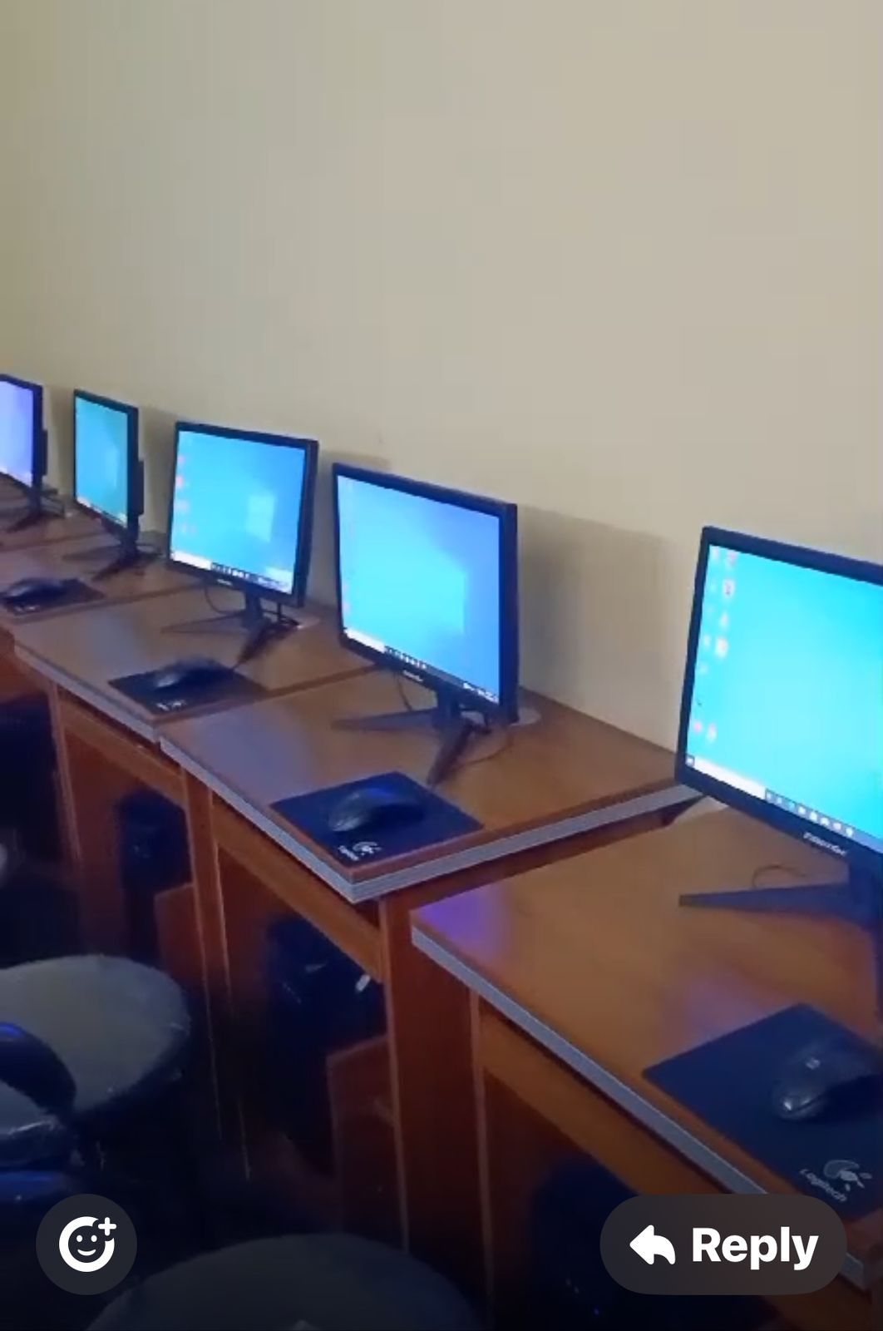
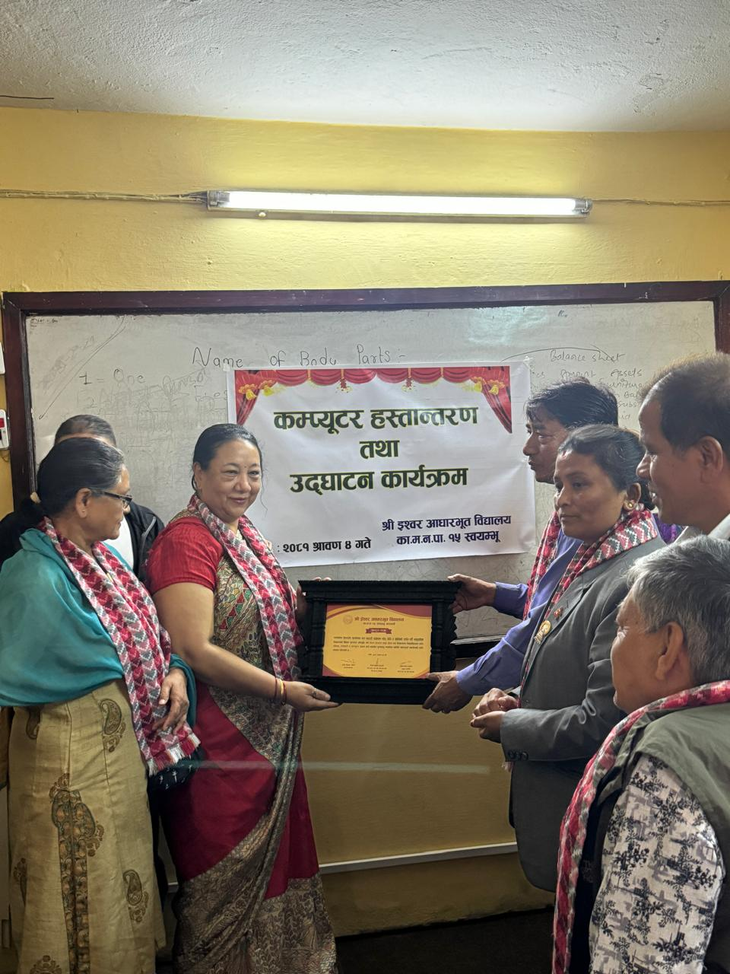
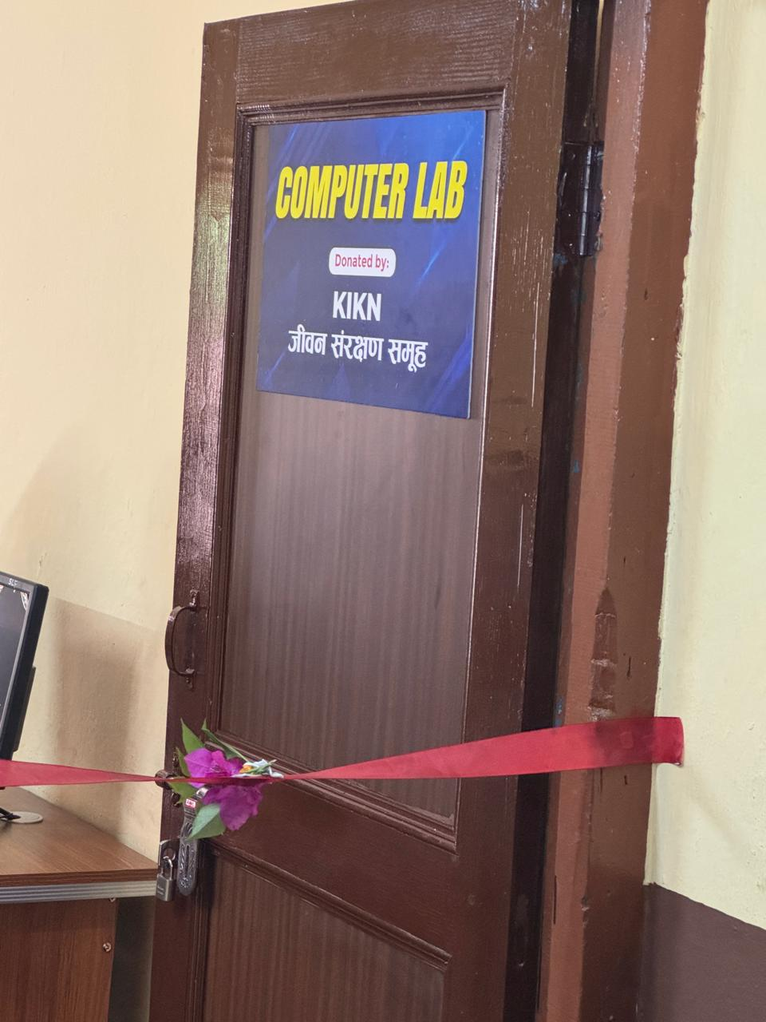
Computer lab setup at Ishwor Basic School

Slide 14
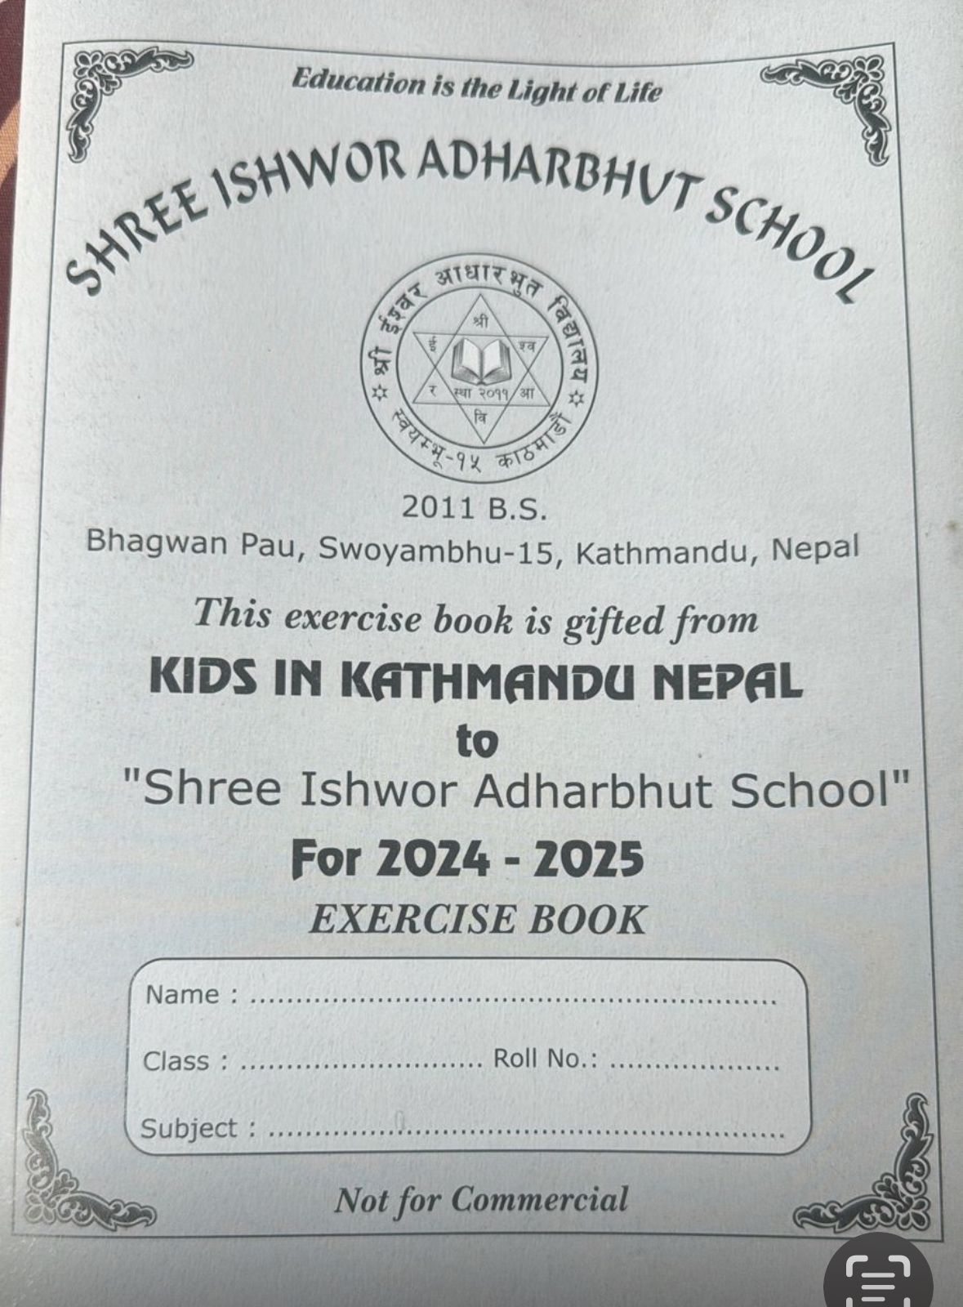
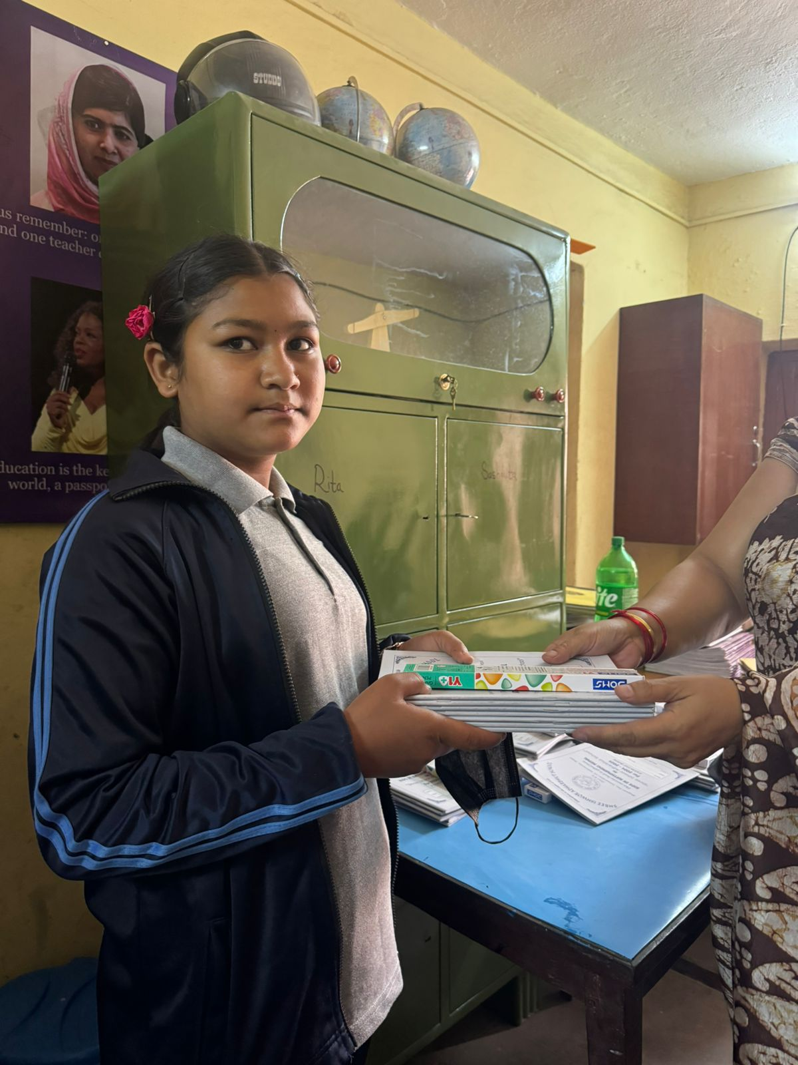
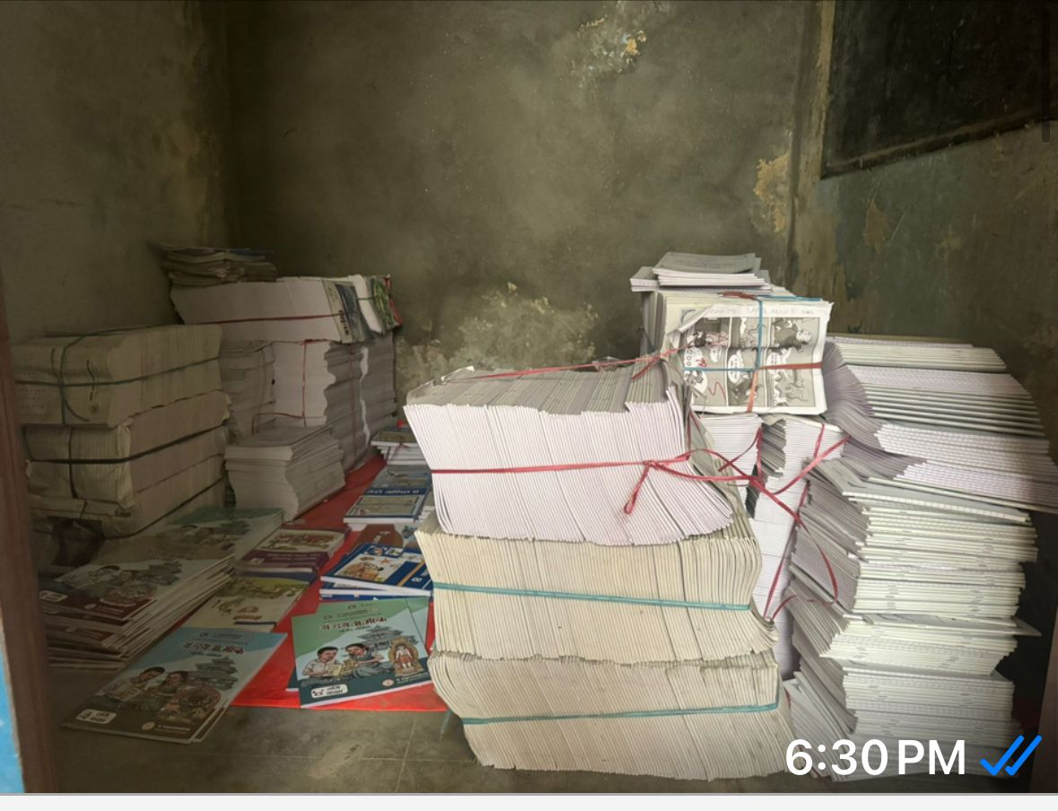
Education material distribution at Shree Ishwor Basic School

Slide 15
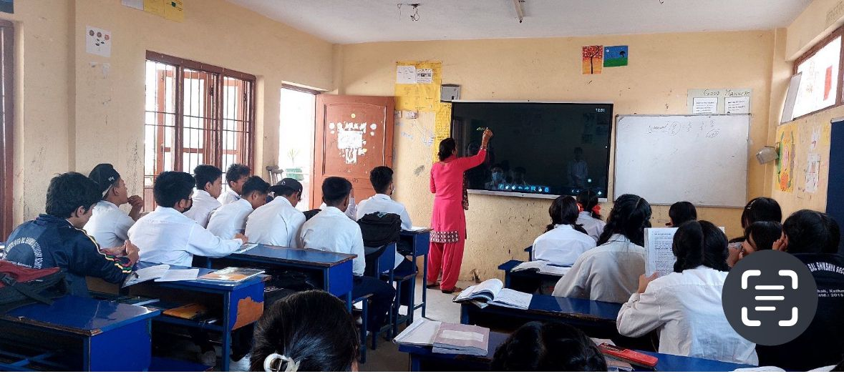
Smart board setup at Guheshwori Higher Secondary School

Slide 16
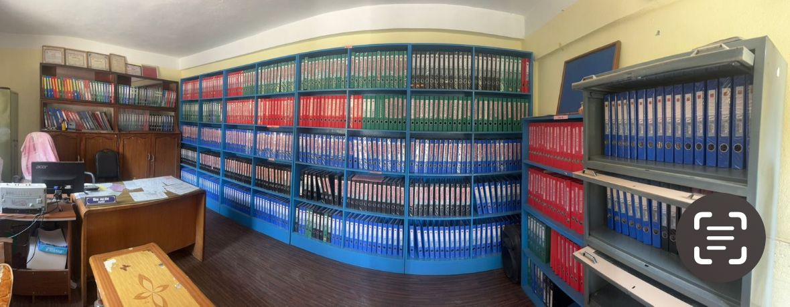
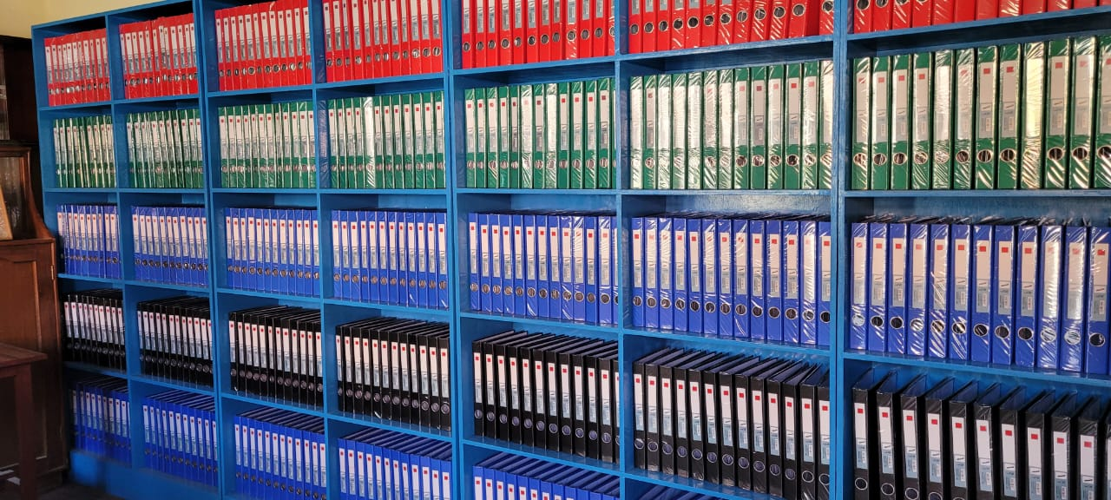
File rack donation at Buddha School ,Godawari

Slide 17
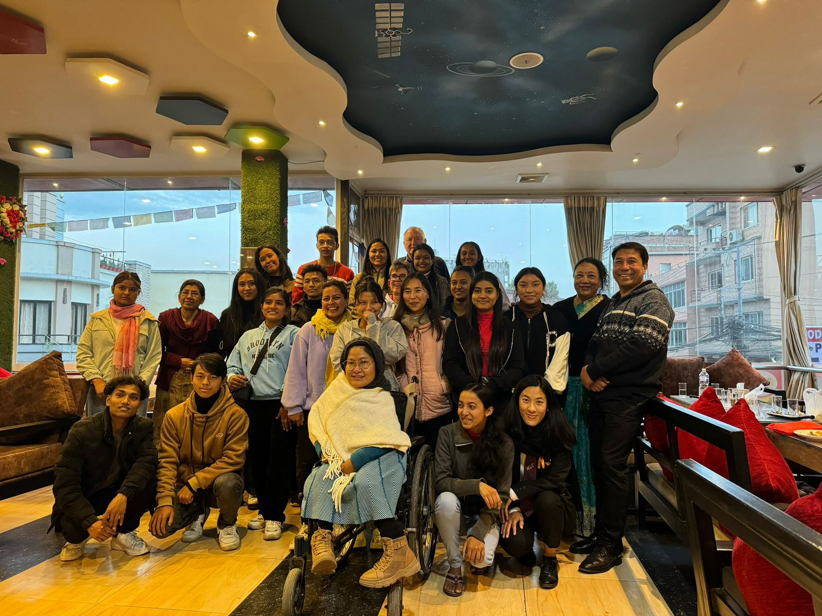
Open day

Slide 18
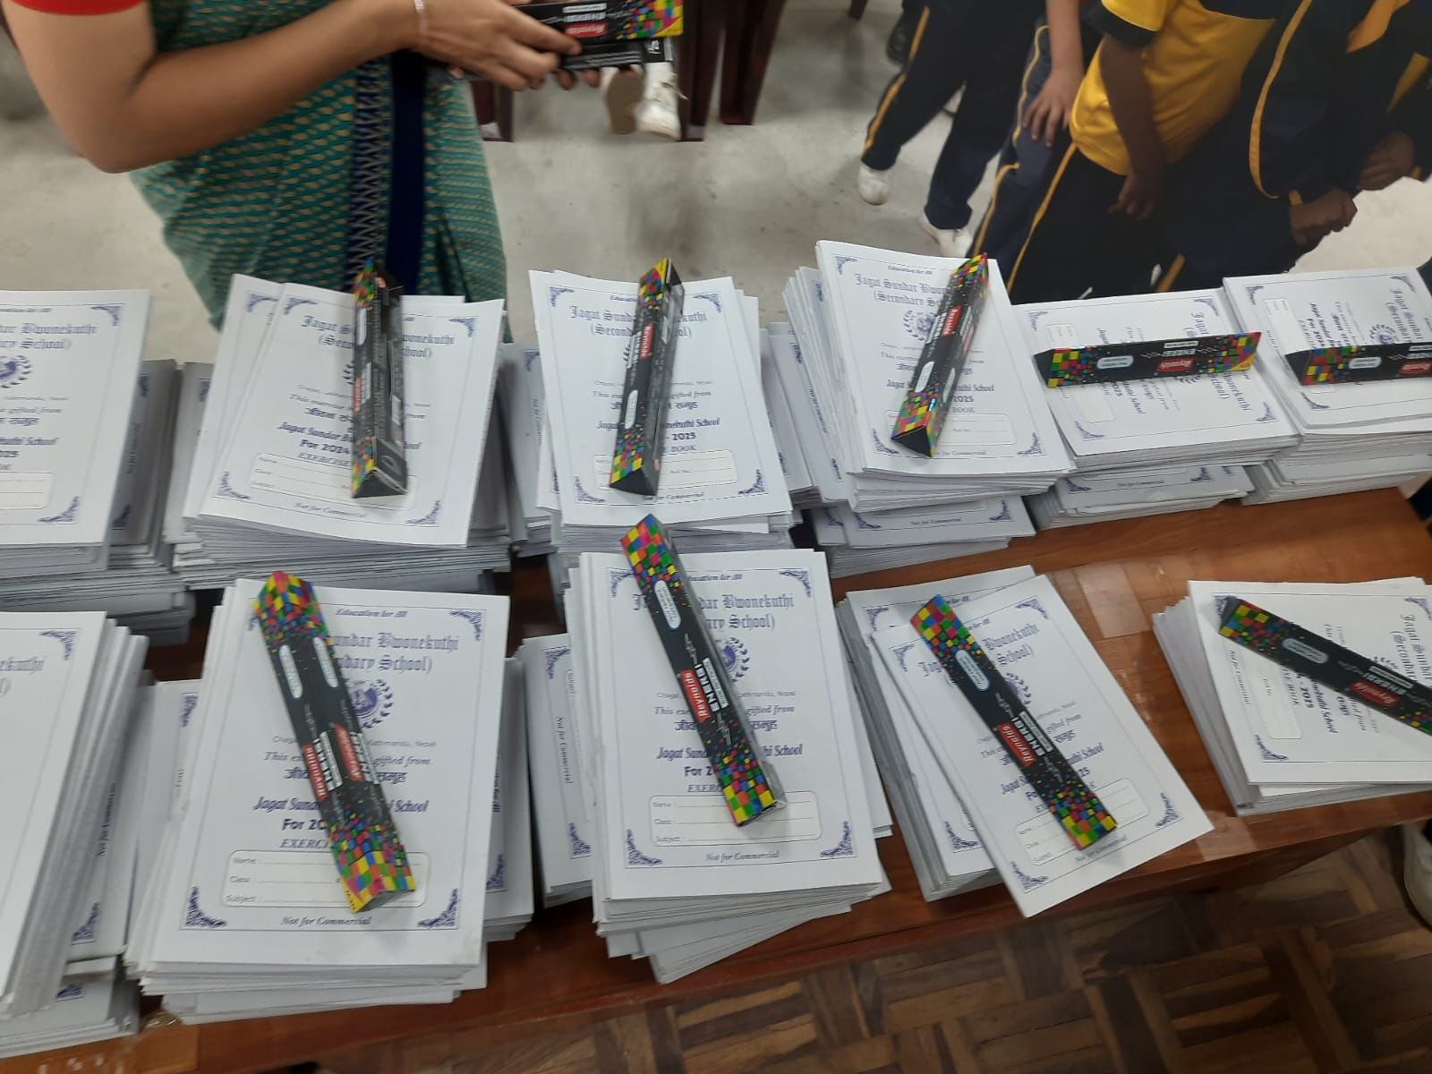
Educational material distribution at Jagat Sundar Bwonekuthi School

Slide 19
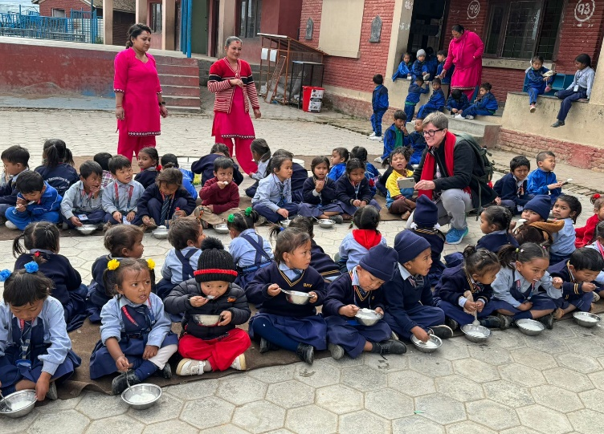
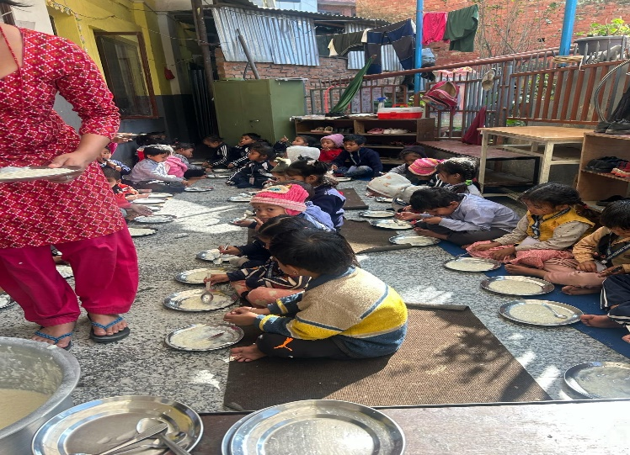
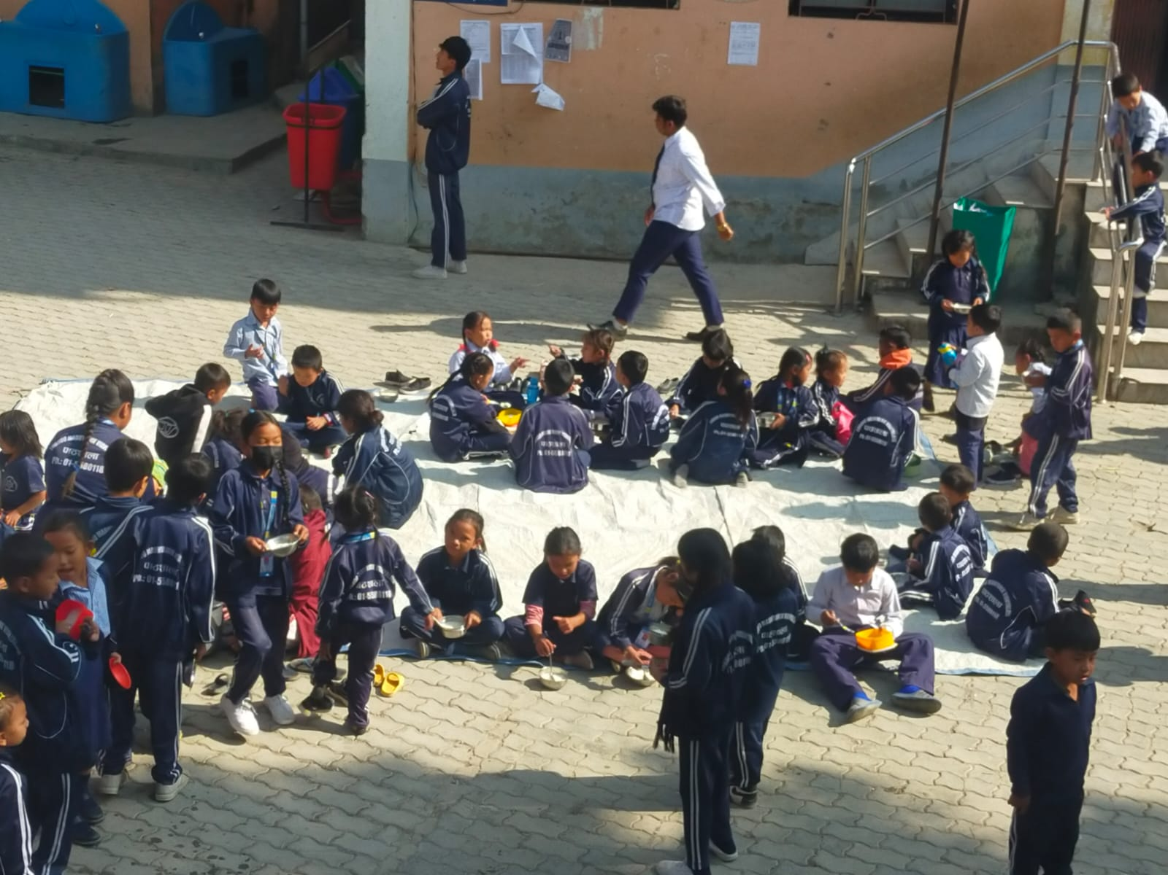
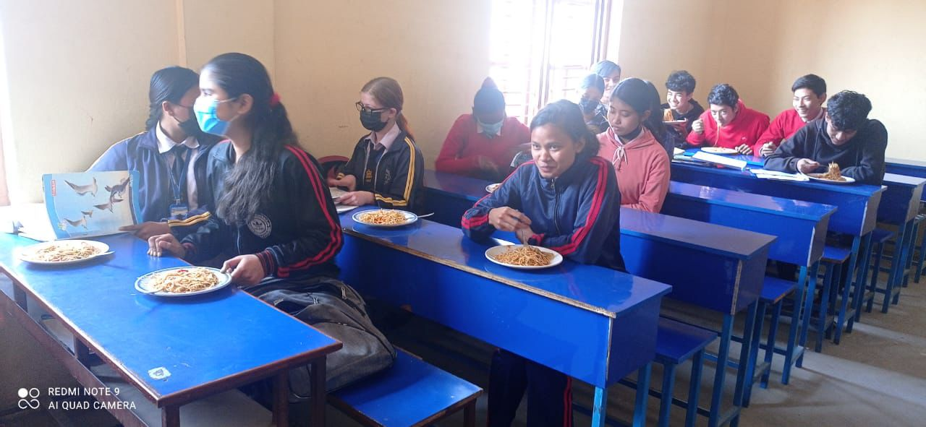
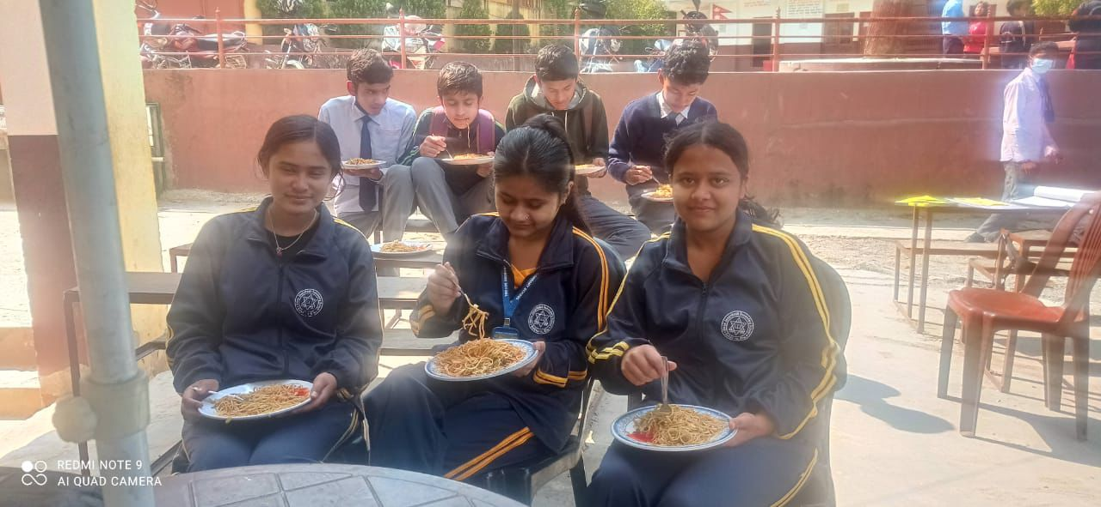
Midday Meal Distribution

Slide 20
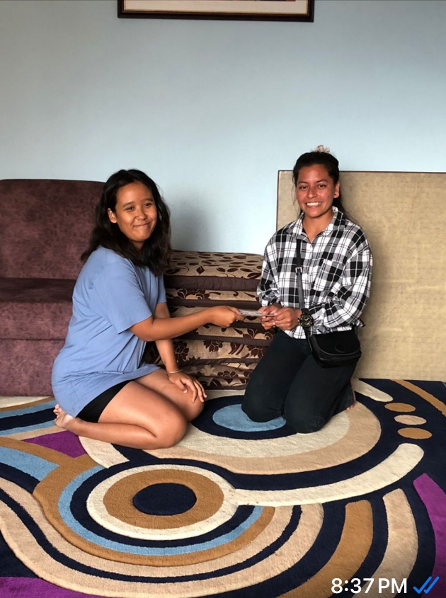
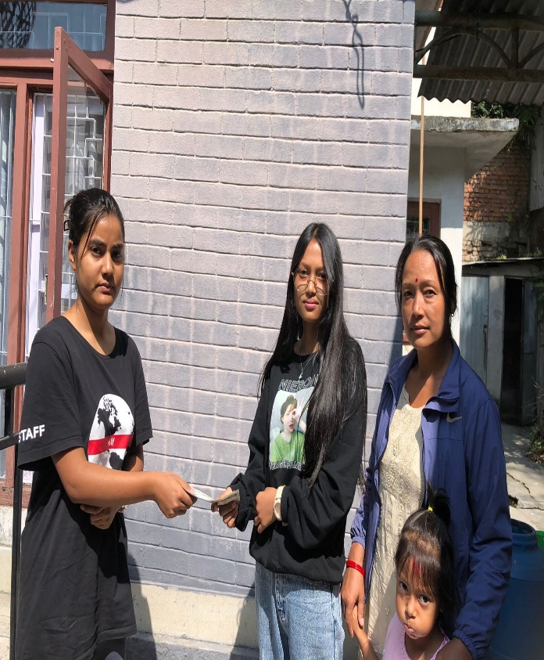
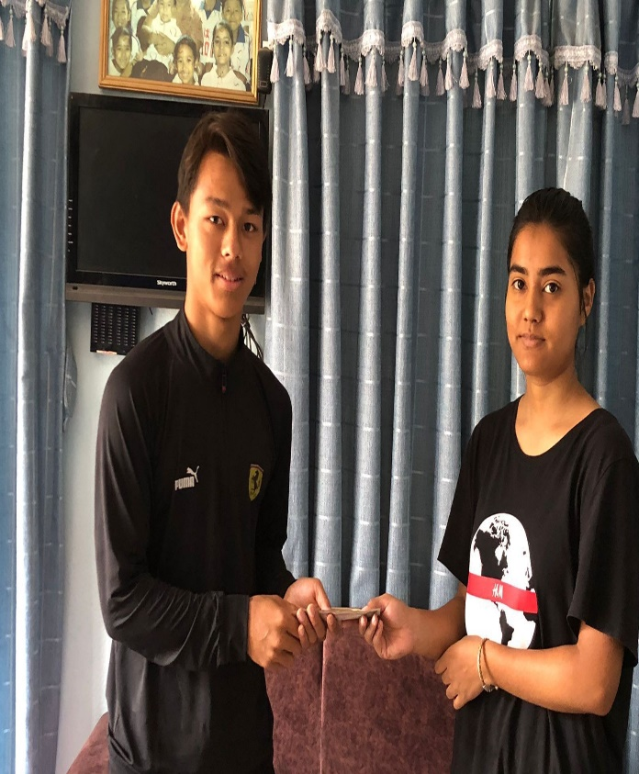
Festival fund distribution

Slide 21
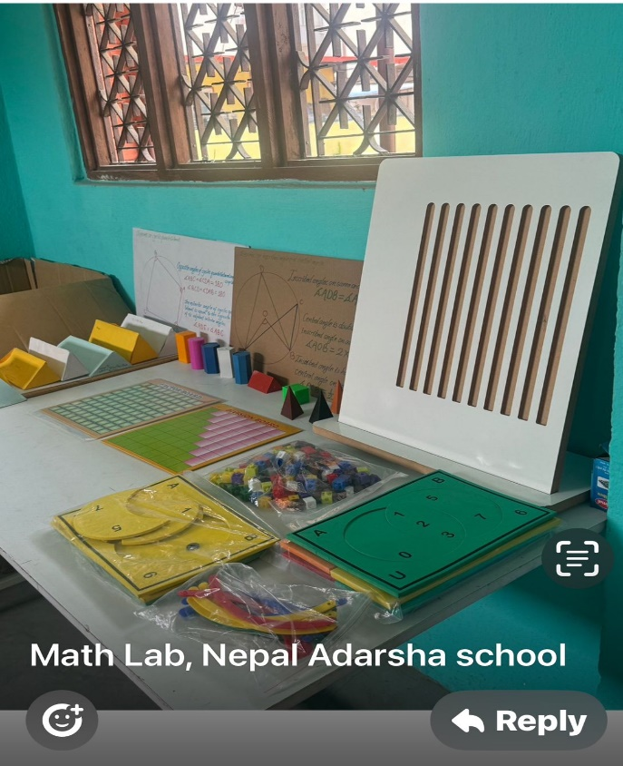
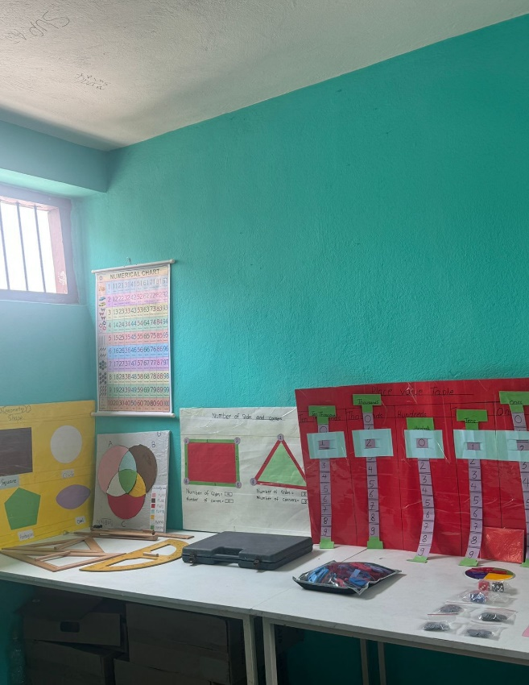
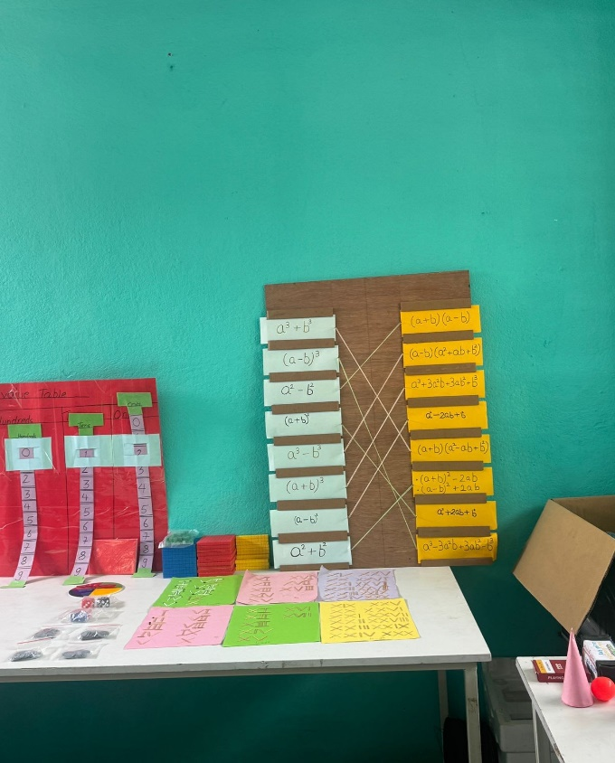
Math's lab setup at Nepal Adarsha School

Slide 22
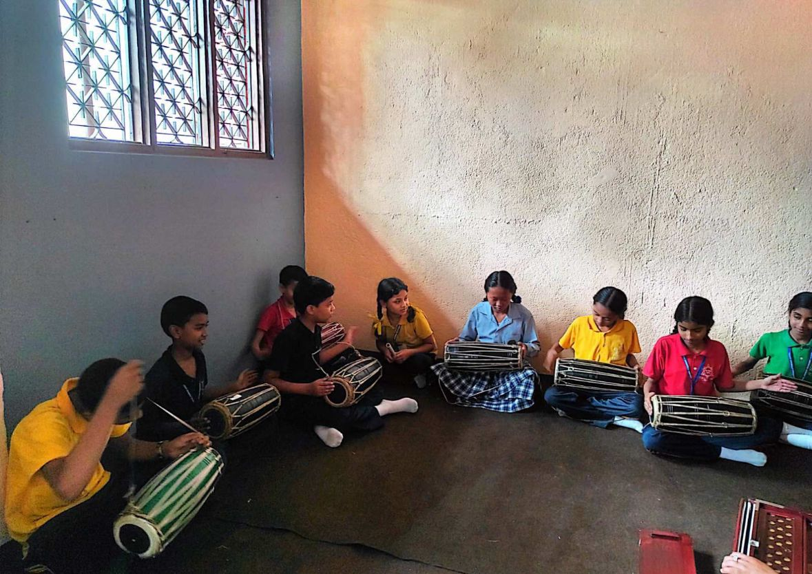
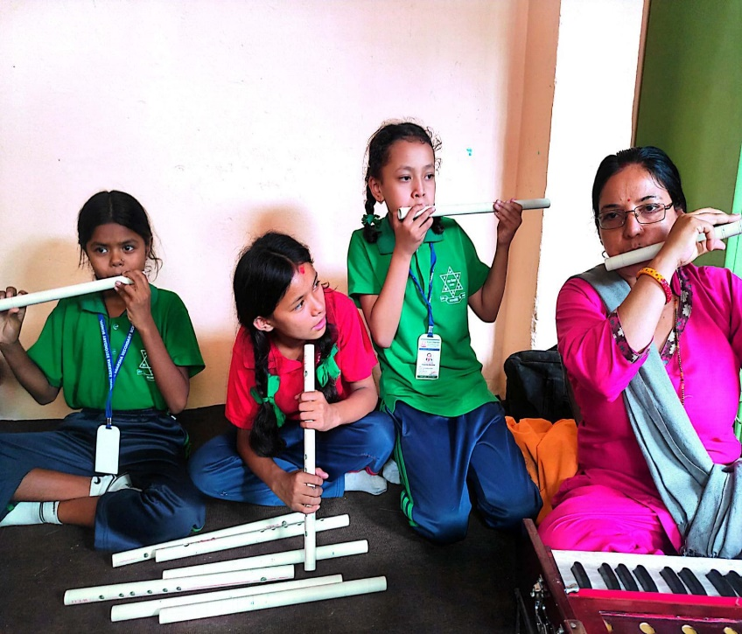
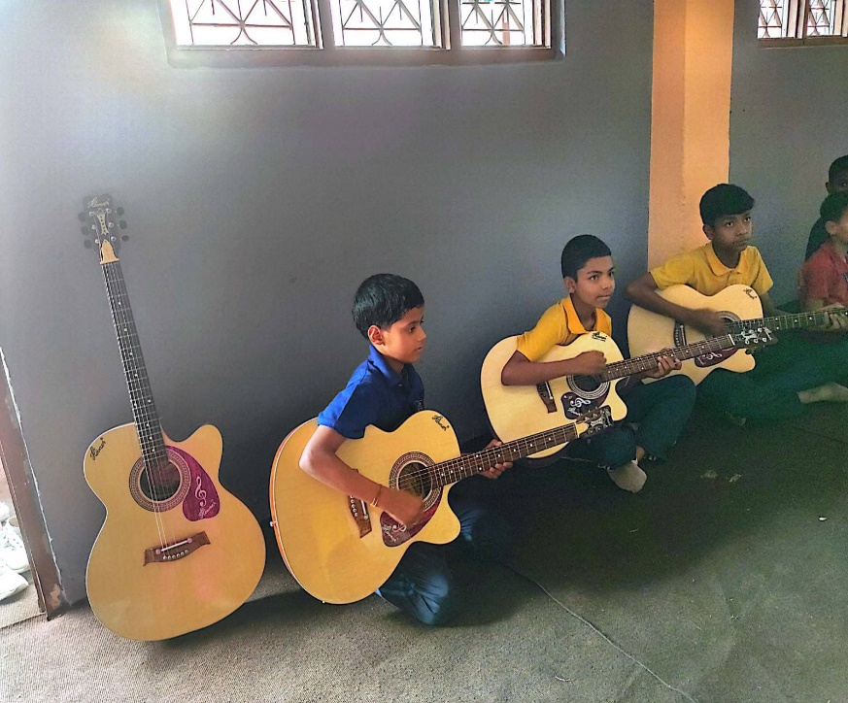
Musical instrument donation to Nepal Adarsa School

Slide 23
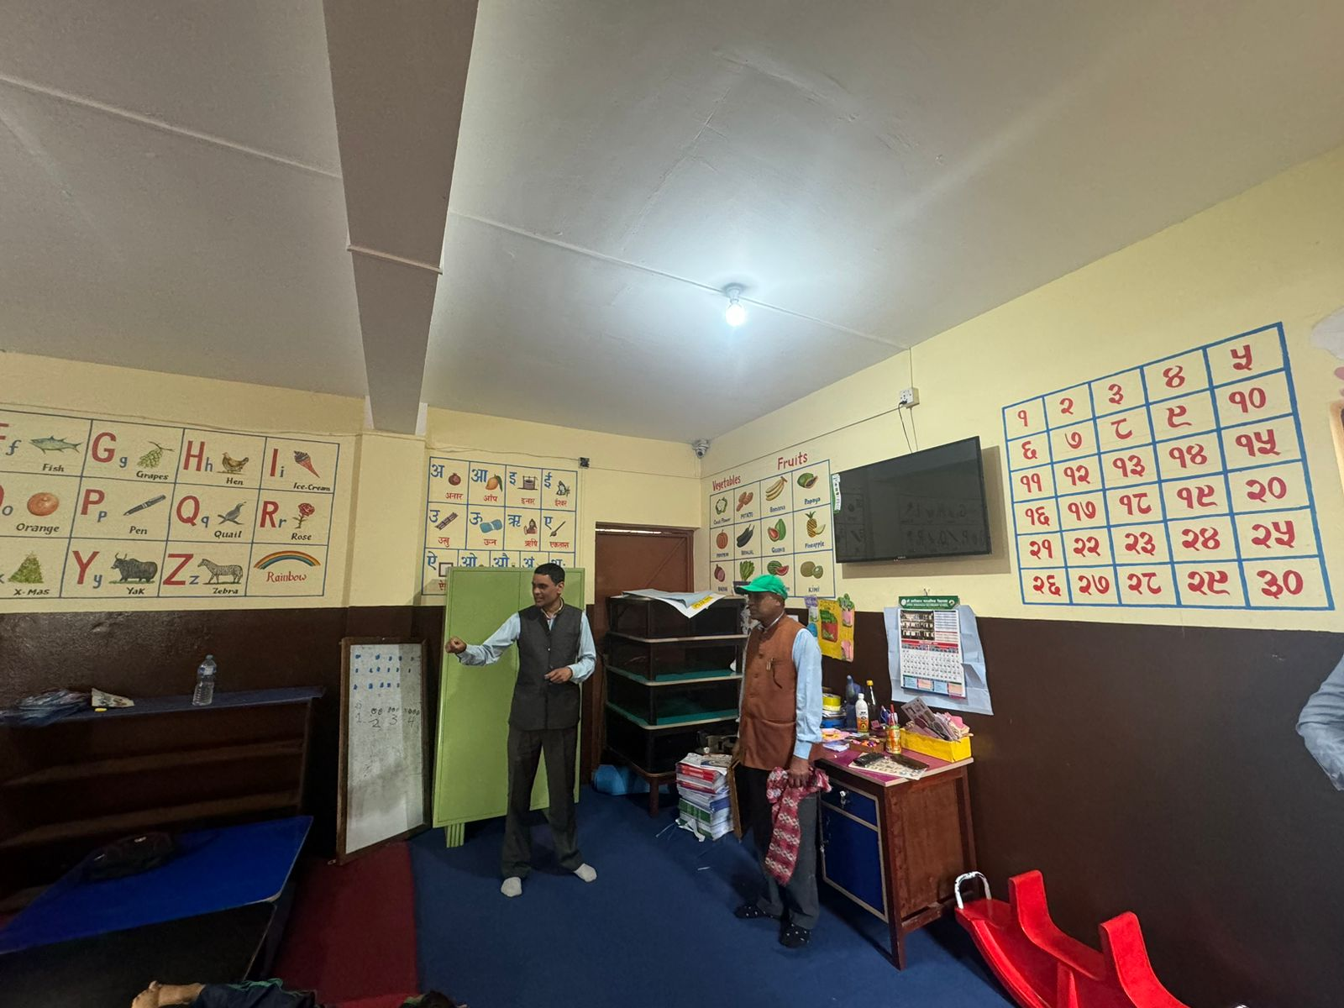
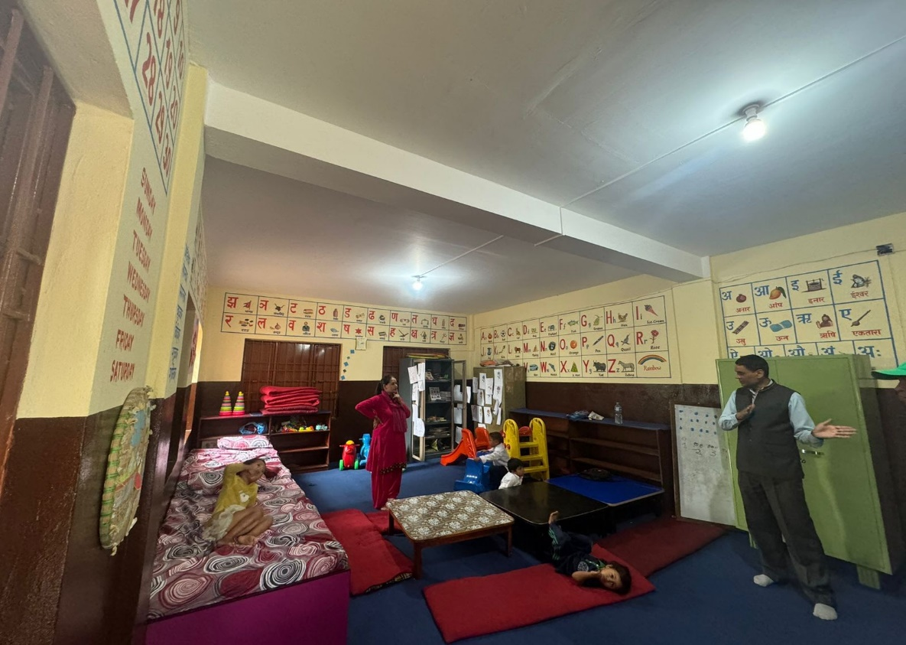
ECD setup at Jana Bikash school

